Slide 1
Software Product Engineering
Dr Daniel Schien and Dr Simon Lock

Slide 2
Key learning outcomes of this unit
Work as part of an integrated development team
To build a real-world software system
Of significant size and complexity
For a real client organisation with real business problems:
Public sector organisations
Small and Large Businesses
Academics/ Departments
Charities & Social Enterprise

Slide 3
What this unit is NOT about
This is NOT just another programming unit
(Where you get a text description and just need to code it up)
This is disciplined systems engineering
It is not a "death or glory" hackfest
No lone maverick hackers heroically conjuring up mysterious code
This is managed and repeatable engineering of complex systems

Slide 4
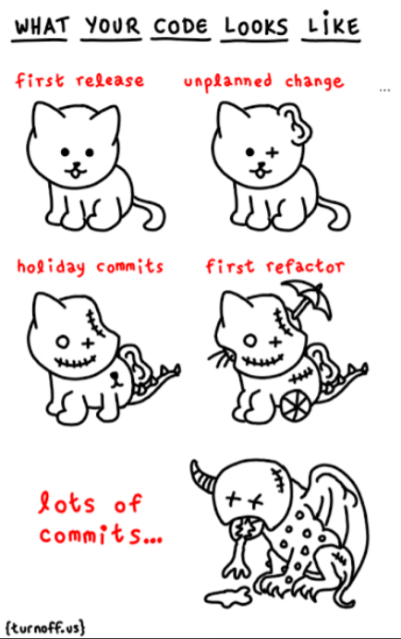
Your code currently be like…
“Managed and repeatable engineering of complex systems ?”

Slide 5
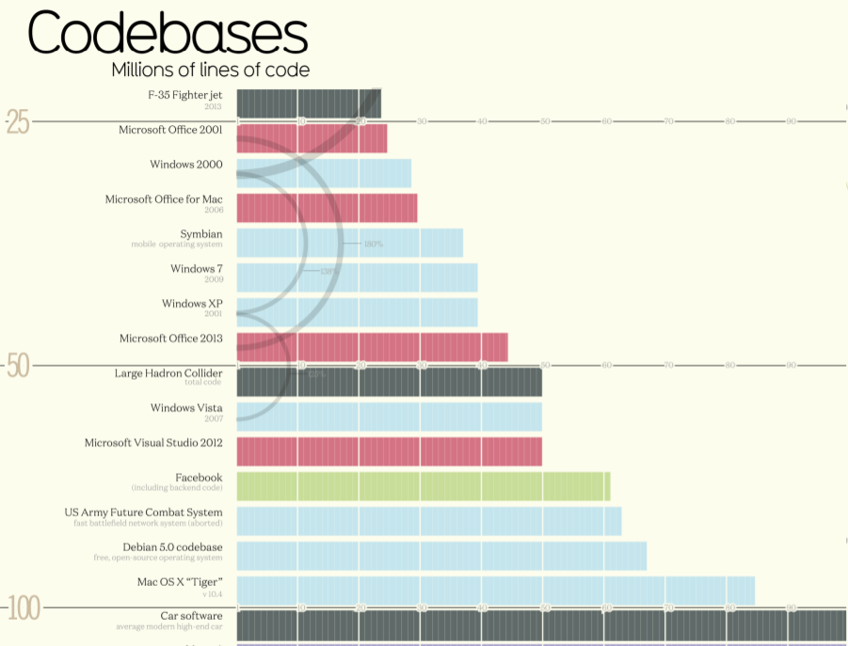

Slide 6
Essential Skills
Planning
Requirements analysis
Object-Oriented Design
Testing
System Integration
Releases & Deployment
Working as a Team
Cultivating client relationship
Evaluation & Feedback

Slide 7
Organisational Structure
Think of Dan and Simon as CEOs of a large development company
Managing over 30 projects
We have drafted in mentors as middle management
Not technical support, but for monitoring and guidance
You will meet with them every 2 weeks (or so)
They will push out information
Engage you in discussion
Gather feedback to pass back to Dan and Simon

Slide 8
Forming Teams
There are various different approaches to forming teams
We have found the best way is to let students cluster around projects
In the practical session (next) we will release the projects
Using our custom SPE content management system !!!
You may browse them and indicate your preferences
In true spirt of Com Sci we’ll use an algorithm to determine best fit
Pareto optimality - for the greater good !
No guaranteed allocation (soz !)

Slide 9
Implementation Technologies
We need consistency across the cohort if we hope to provide support
You are free to choose libraries / frameworks as appropriate
But Java must be your main implementation language:
Android mobile Apps
Java Server-side application framework (Spring Boot !)
Naturally, for web UIs you will have to use HTML/JS/CSS
Discuss with us if any of this is impractical for your client/domain

Slide 10
Development Support Tools
GIT or Subversion repositories for code / document sharing
Your favourite editor (might make sense to agree on one for team)
We recommend Maven as a build tool
Open Project for project management support (more next lecture !)
You may like to explore other communication and collaboration tools

Slide 11
Assessment
A Light-touch documentation portfolio
The nature and quality of your development process
Team dynamics and relationship with client
The quality and extent of your finished product
"Viva" style presentation and discussion

Slide 12
Milestones
Choose your project preferences: 3rd October (by 13:00)
Teams finally allocated: Ready for 5th October !
First meeting with client: Week of 8th October (Most arranged on 10th)
Initial Requirements & Design documents: 16th November (13:00)
Deploy “Minimum Viable Product” release: 12th December (13:00)
Deploy “Beta Version” release: 13th February (13:00)
Deploy “Final Version” release: 17th April (13:00)
Submit full portfolio: 17th April (13:00)
Viva Presentation & Discussion: From 29th April

Slide 13
Team Effort
This is a team effort - you must work together
Your group mark will be determined by the output of the entire team
Your individual grade will determined by your contribution to the group
An individual cannot out-perform the team envelop and get a better grade
But they can under-perform and get a worse one
Your individual grade will be based on your engagement with the projects
(as assessed by a number of metrics - to be explained in the next lecture)

Slide 14
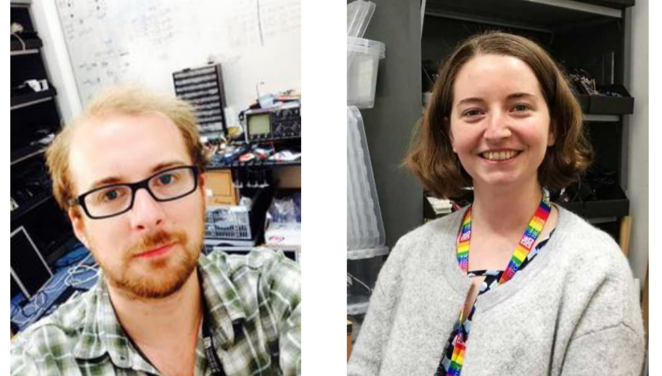
Support from Rich and Beth

Slide 15
Syllabus
}
Week 01: Introduction
Week 02: Software Process
Week 03: Integration, Verification & Validation
Week 04: Requirements Engineering
Week 05: Object Oriented Design
Week 06: Java Server Implementation
Week 07: User Interface Design
Week 08: CS Explore
Week 09: Datafeeds and Databases
Week 10: Web Dashboard Elements
Week 11: Evaluation and Feedback
Week 12: Progress and recap
Process Knowledge
}
Technical Skills

Slide 16
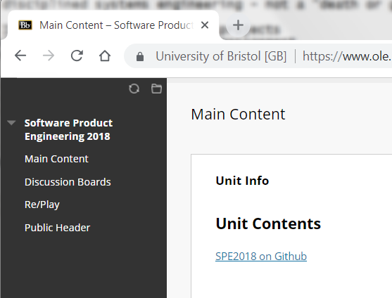
Lecture materials available “through” Blackboard

Slide 17
Timetable
2 Lectures per week
Weekly practical session exercises
Meetings with mentors
Meetings with clients
Co-located working as a team
"Reserved" Wednesday mornings

Slide 18
Questions ?

Slide 19
Let’s see some examples…

Slide 20


Slide 21
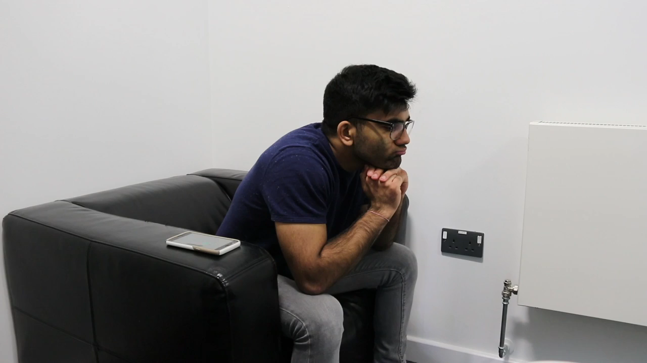

Slide 22
